Slide 1

Background

Slide 2
background-color
Changing the background colour of an element
body { background-color: lightblue; }
Can use specified colours, RGB or HEX + opacity
Or just use RGBA

Slide 3
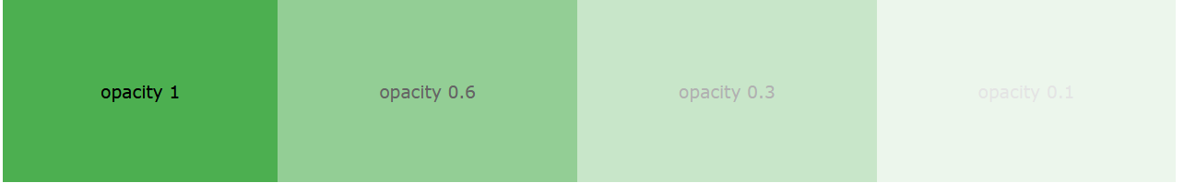
Colours + opacity
We can tell the browser to reduce the opacity of the background as well (so maybe we can overlap different colours together)
div { background-color: green; opacity: 0.3; }

Slide 4
RGBA
We can tell the browser to reduce the opacity of the background as well (so maybe we can overlap different colours together)
div { background: rgba(0, 128, 0, 0.3) /* Green background with 30% opacity */ }

Slide 5
background-image
Specifies an image to be used as a background element
body { background-image: url("paper.gif"); }

Slide 6
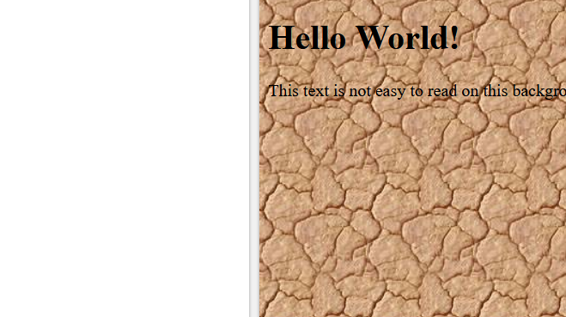
Beware
Do not use colours that is impedes readability
body { background-image: url("paper.gif"); }

Slide 7
background-repeat
By default, an image will be repeated both horizontally and vertically.
However, some images looks weird when set to default setting
body { background-image: url(“gradient.gif"); }

Slide 8
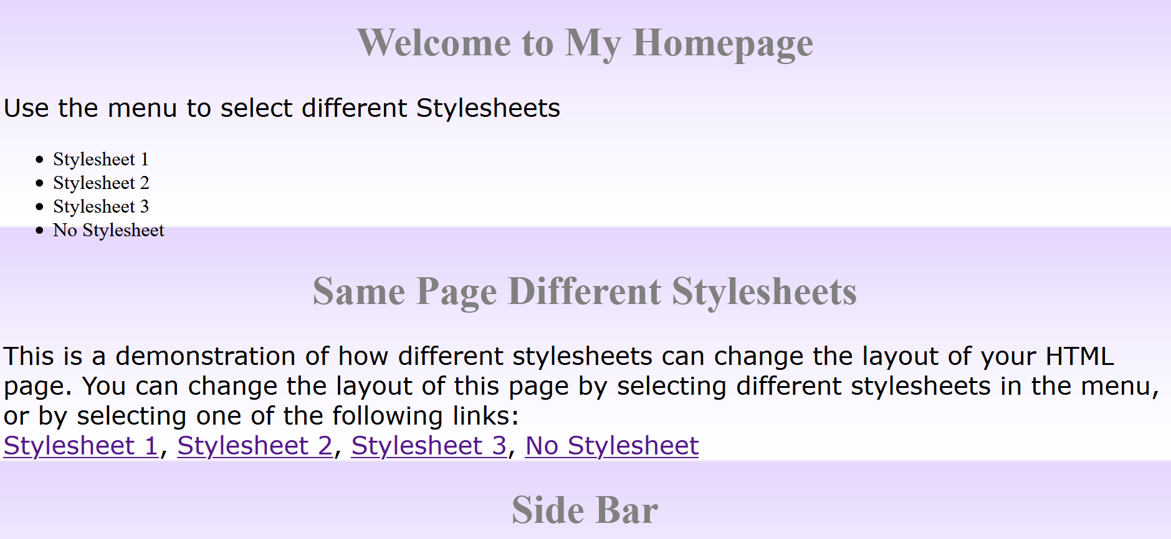
Weird duplication of background
If we just do:
body { background-image: url("gradient_bg.png"); background-repeat: no-repeat; }
Then it’ll look more natural

Slide 9
background-position
By default, an image will be placed at the top
However, we can also specify where the background should start in the page itself.
body { background-image: url(“gradient.png"); background-repeat: no-repeat; background-position: bottom; }

Slide 10
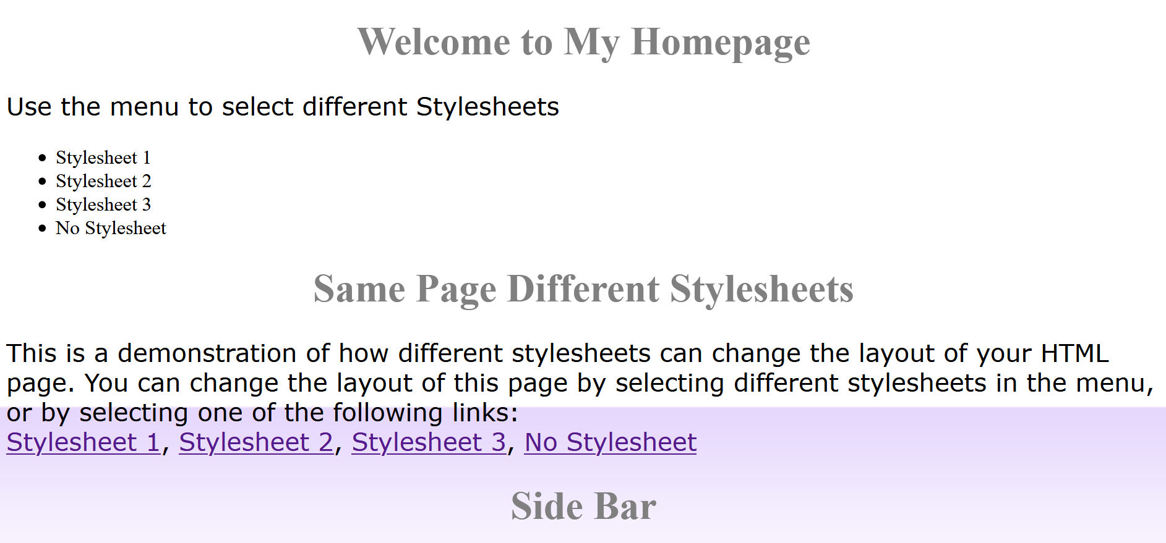
Setting position of background
body { background-image: url(“gradient.png"); background-repeat: no-repeat; background-position: bottom; }
What can you infer from this example itself? Does the “gradient.png” stretch the whole page?

Slide 11
background-attachment
It defines whether the background image should scroll or be fixed from the rest of the page.
body { background-image: url(“gradient.png"); background-repeat: no-repeat; background-position: right top; background-attachment: fixed; }

Slide 12
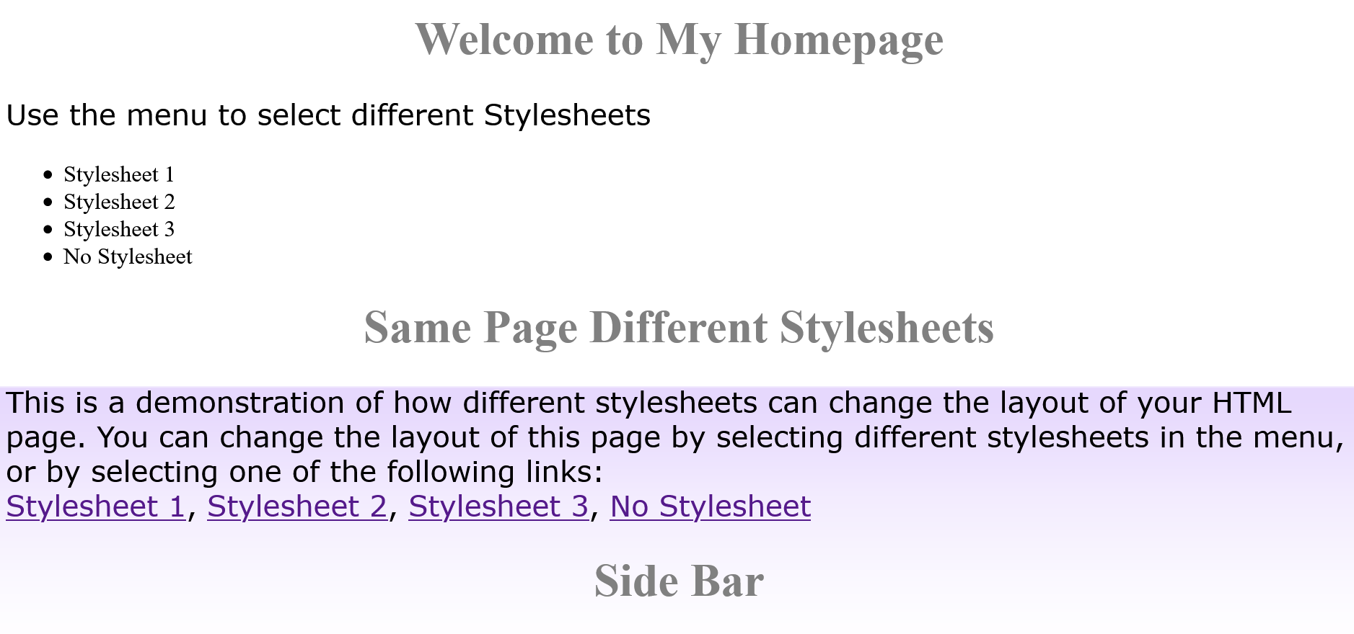
Scroll vs fixed
body { background-image: url(“gradient.png"); background-repeat: no-repeat; background-position: bottom; background-attachment: fixed; }

Slide 13
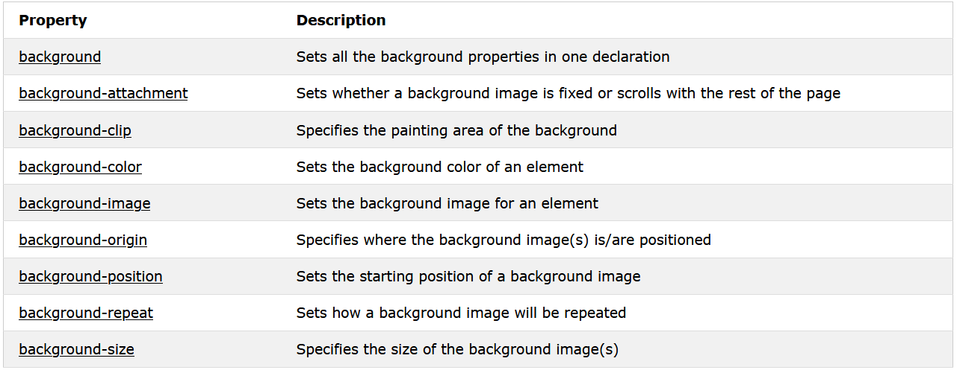
Summary

Slide 14
Task 7
Create a floating icon that floats at the side and follows the user where ever they scroll to.
Let the image bring you to google.com

